Slide 1
Movie prediction system
Hit or Miss

Slide 2
OUR TEAM
Team
Saurav Panda
Nandita Shukla
Aishvarya Laxmi
Srinishi Raviganesh
Siddhant Chanda

Slide 3

HIT OR MISS
Hit or miss - an application made for the entertainment industry, with its prime focus on maximising the revenue generated by a movie, by predicting its success rate.
Through through understanding and analysis of our dataset, we have studied the trends over the years, and found out interesting relationships between various parameters and their mutually dependency , which we believe can greatly help us in predicting the success of our movie.
We then use various models such Naive Bayes , KNN, and predict whether a movie will be successful or not, based on our predictors.

Slide 4
CRISP-DM
MODEL
We have based our model on CRISP-DM
Business Understanding
Data Understanding
Data Preparation
Modeling
Evaluation
Deployment

Slide 5
Business understanding

Slide 6
Business understanding
Project objective: As our name suggest, the main objective of the project is to predict whether a movie will be a hit or a miss.
Requirement of the business: We observed the entertainment industry is a very volatile , and a lot of times big budget movies that are expected to perform at box offices fail. This leads to people ranging from producer , director and as well as the actors losing a lot of money. But if there could be a medium which could give a credible prediction of whether the movie movie will be successful or not, this could be prevented. And this is exactly where we come in.
Idea of potential data: As we are analysing a movie and its rate of success , we need a dataset with various factors that we think could be responsible for the success of the movie .

Slide 7
Data Understanding

Slide 8
data understanding
We acquired three datasets from the internet that could have potentially be used for the analysis at hand .We took the data set that had the minimum null values and redundancy for our analysis .The data had the following columns with their descriptions given below:
• Budget: An estimate of expenditure required for production
• Company : The production house that sponsors the movie
• Country : The country in which the movie is set to be released
• Director : Name of the person in charge
• Genre : Style or category of movie
• Movie name: The name under which the movie is set to be released
• Runtime: The duration of the movie in minutes
• Star: The leading actor of the movie
• Writer: Name of the Person who wrote the script
• Year: Year when the movie is set be released
• Month: Month in which the movie to decided to be released

Slide 9
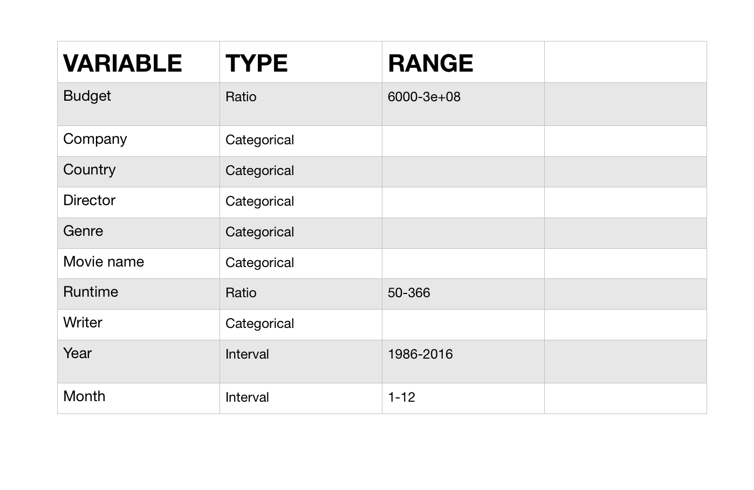
TYPE AND RANGE OF DATA
DATA UNDERSTANDING
Number of rows:6820 | Number of columns:17

Slide 10
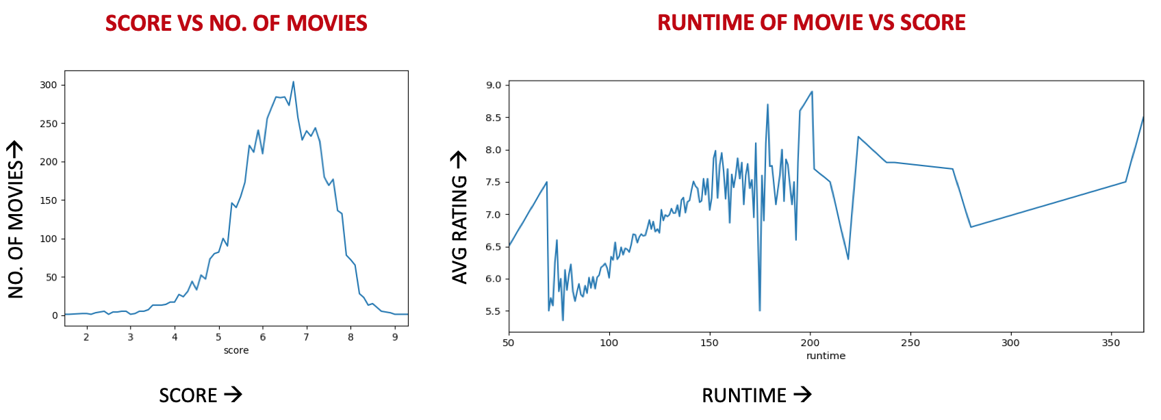
Data understanding
Some observations we made while analysing the data

Slide 11
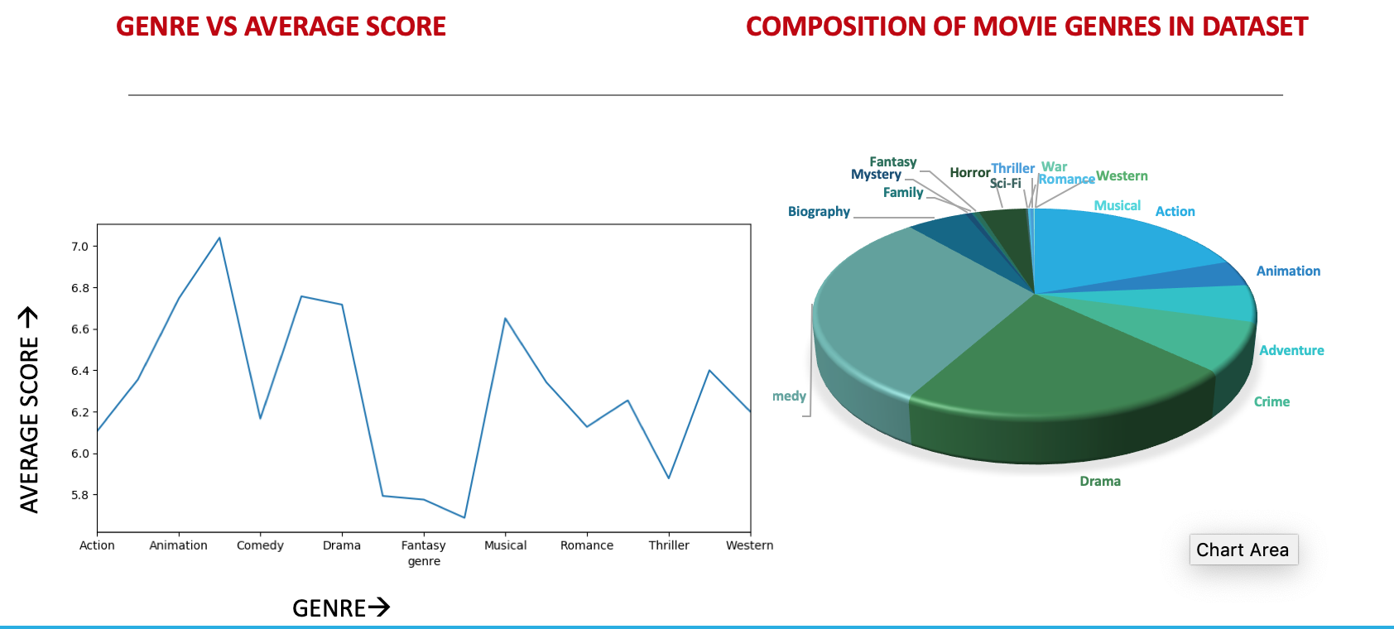
Data understanding
Genre vs Average Score

Slide 12
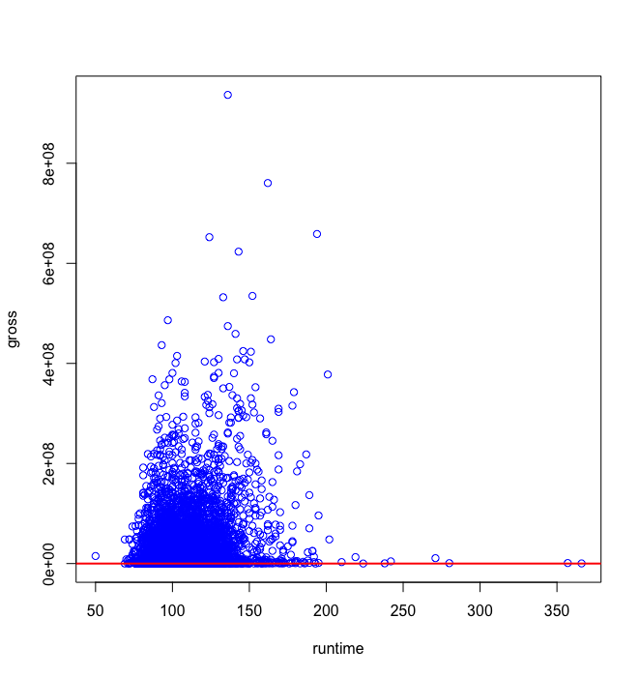
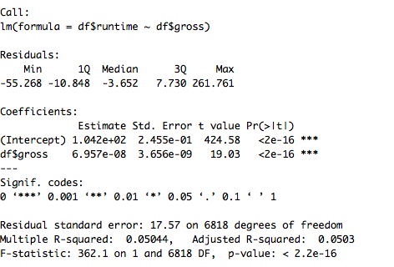
Data understanding
Runtime Vs Average revenue Grossed

Slide 13
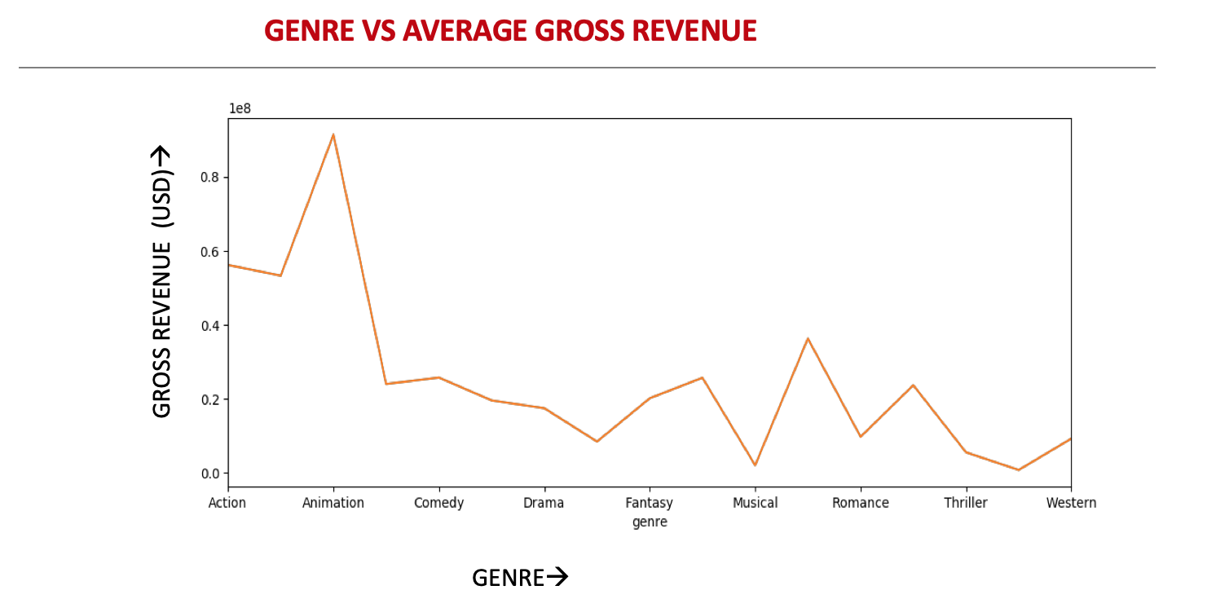
Data understanding
Analysing which genre generates the most revenue.

Slide 14
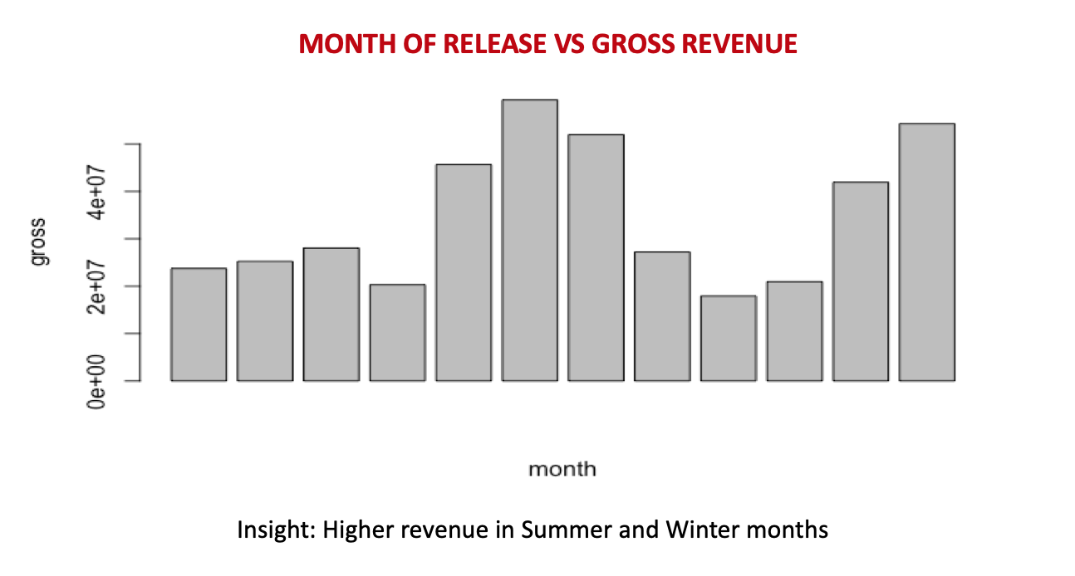
Data understanding
Gross vs the month of release

Slide 15
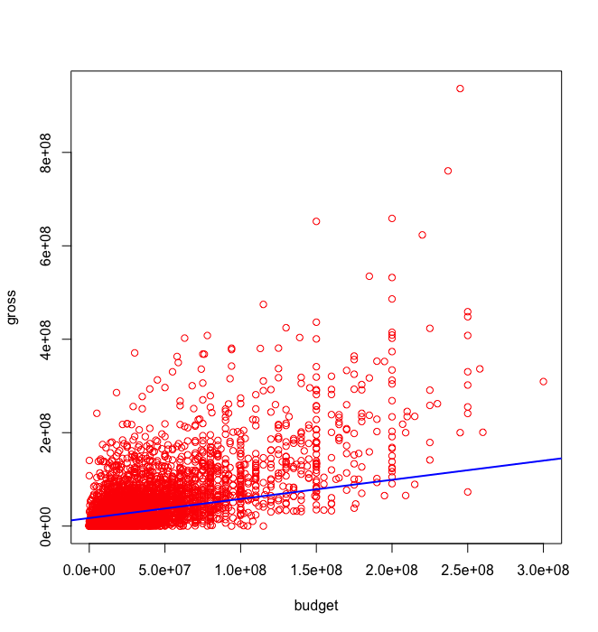
Data understanding
Gross vs Budget

Slide 16
Data preparation

Slide 17
Data preparation
The dataset was fairly clean and precise with few redundant values, missing values and outliers
The missing and redundant values were removed using excel functions
The outliers were identified using box plot and later removed

Slide 18
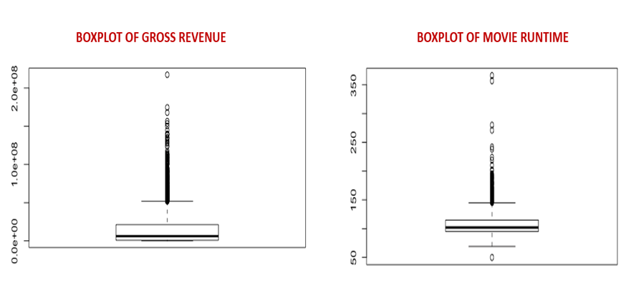
Data preparation
The boxplots were used to remove outliers. The values above and below minimum and maximum value of whiskers point out the outliers.

Slide 19
MODELING

Slide 20
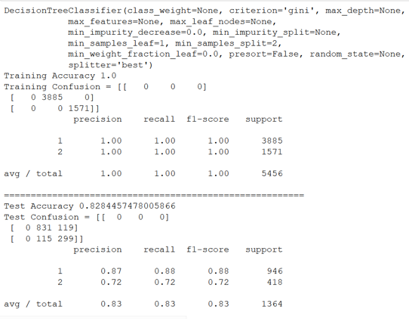
Modeling
Features :
Dependent : Gross revenue
Independent
Budget
Country
Genre
Rating
Run time
Score
Vote

Slide 21
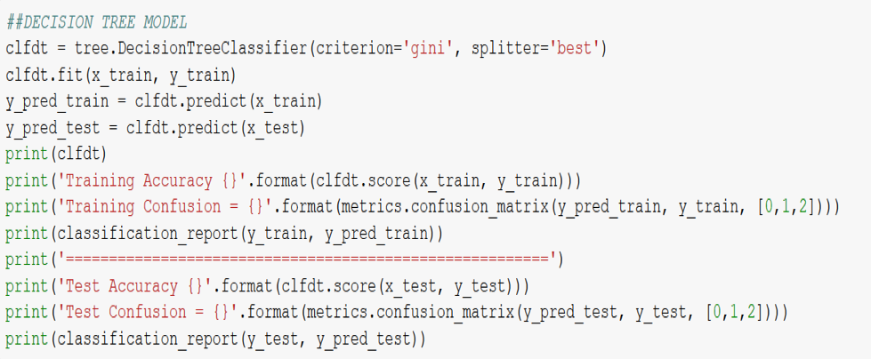
Modeling
Decision tree classifier

Slide 22
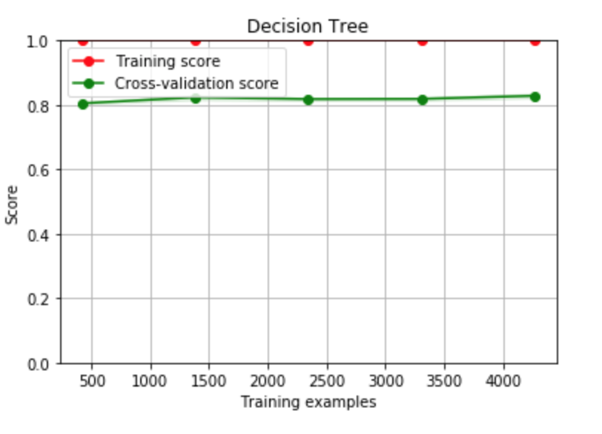
Modeling
DECISION TREE

Slide 23
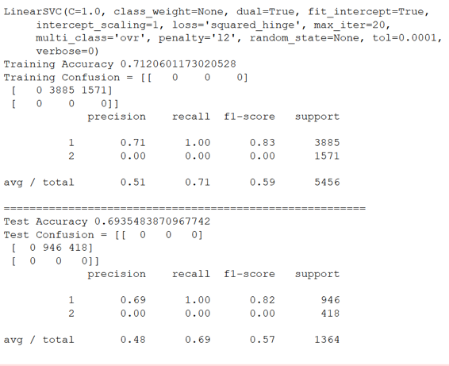
Modeling
Support Vector Machine
Dependent : Gross revenue
Independent
Budget
Country
Genre
Rating
Run time
Score
Vote

Slide 24
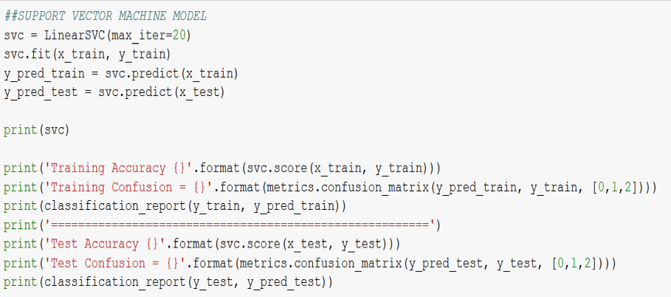
Modeling
Support Vector Machine

Slide 25
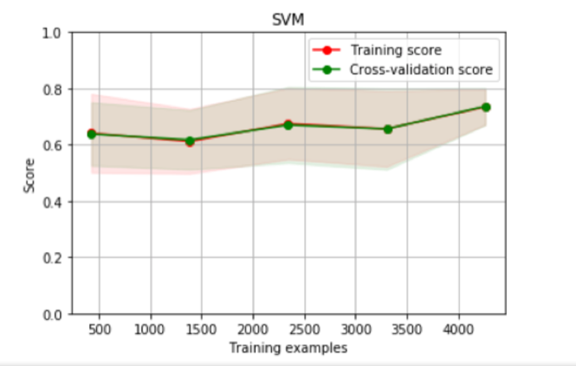
Modeling
Support Vector Machine

Slide 26
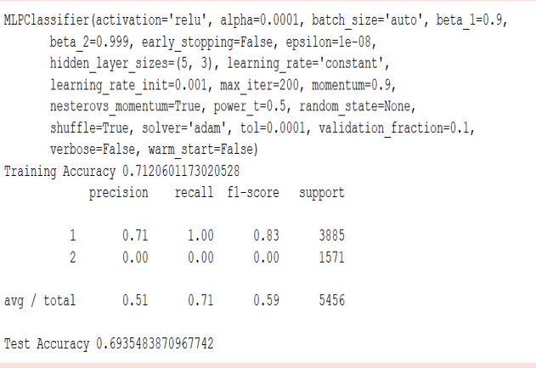
Modeling
Neural Network
Dependent : Gross revenue
Independent
Budget
Country
Genre
Rating
Run time
Score
Vote

Slide 27
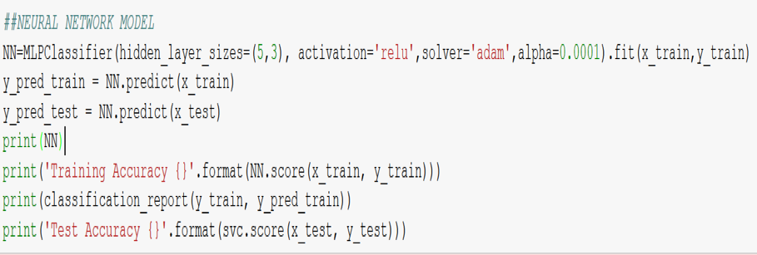
modeling
NEURAL NETWORK

Slide 28
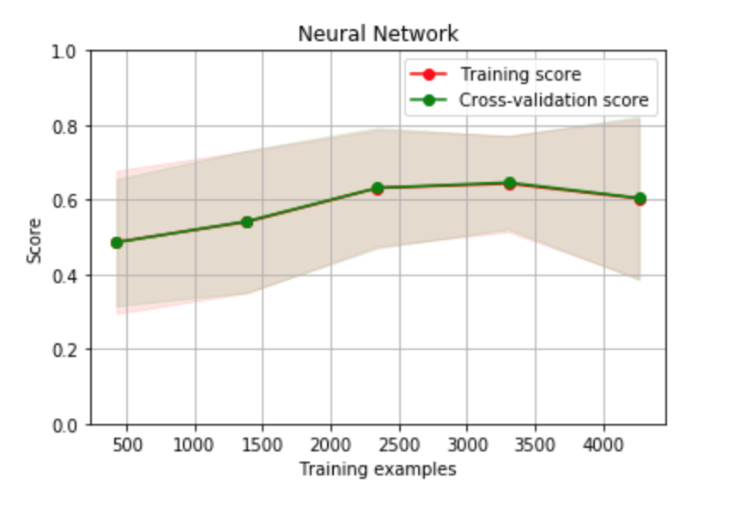
Modeling
Neural Network

Slide 29
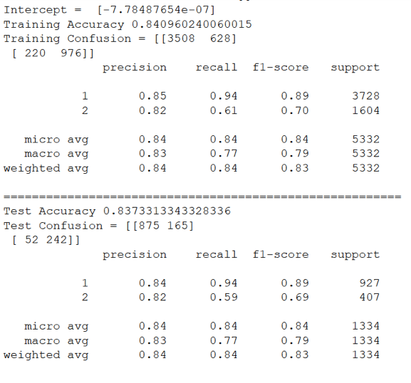
Text
Logistic Regression
Dependent : Gross revenue
Independent
Budget
Country
Genre
Rating
Run time
Score
Vote

Slide 30
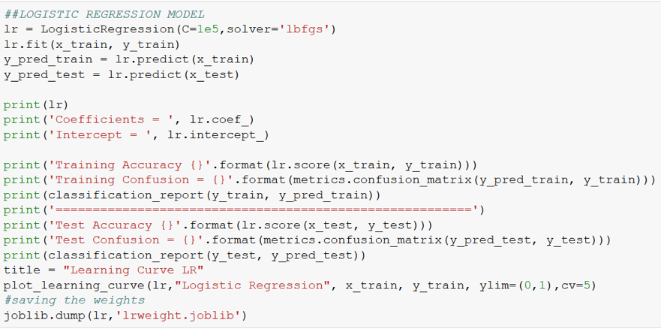
Text
Logistic Regression

Slide 31
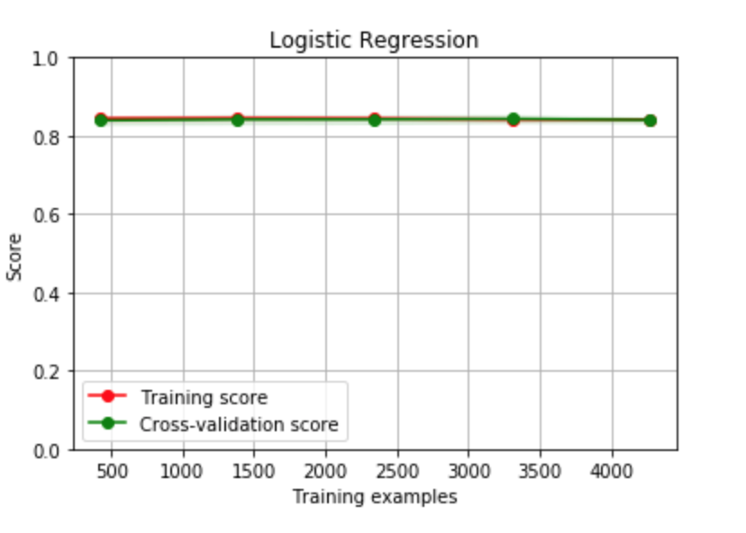
Modeling

Slide 32
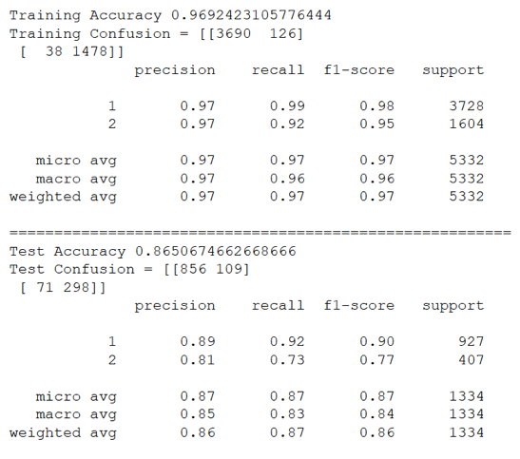
Modeling
Random Forest Classifier
Dependent : Gross revenue
Independent
Budget
Country
Genre
Rating
Run time
Score
Vote

Slide 33
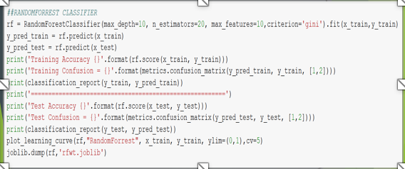
Text
Random Forest Classifier

Slide 34
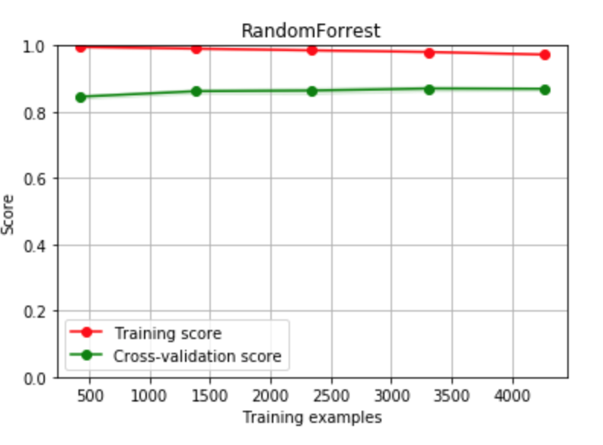
MODEL
Random Forest Classifier

Slide 35
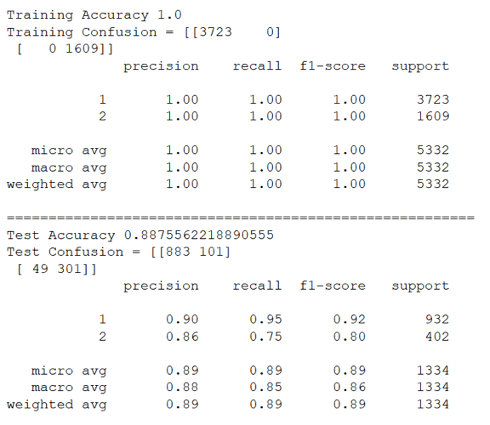
Modeling
Extra Tree
Dependent : Gross revenue
Independent
Budget
Country
Genre
Rating
Run time
Score
Vote

Slide 36
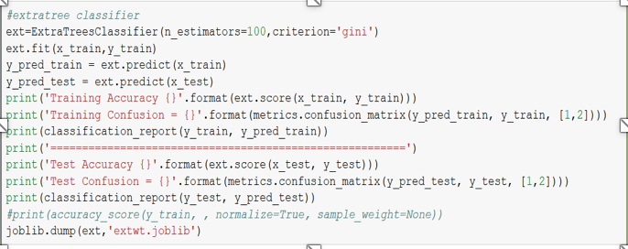
Text
Extra Tree

Slide 37
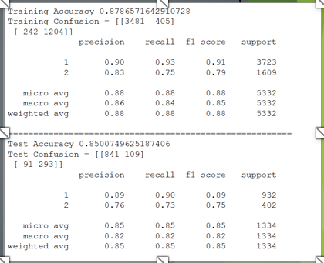
Modeling
KNN CLASSIFIER
Dependent : Gross revenue
Independent
Budget
Country
Genre
Rating
Run time
Score
Vote

Slide 38
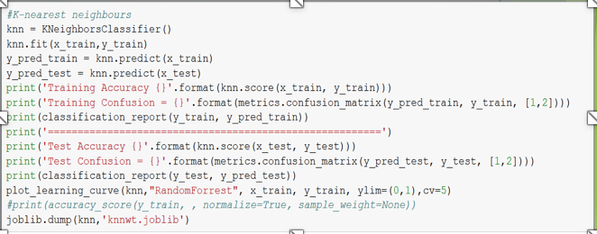
Modeling
KNN

Slide 39
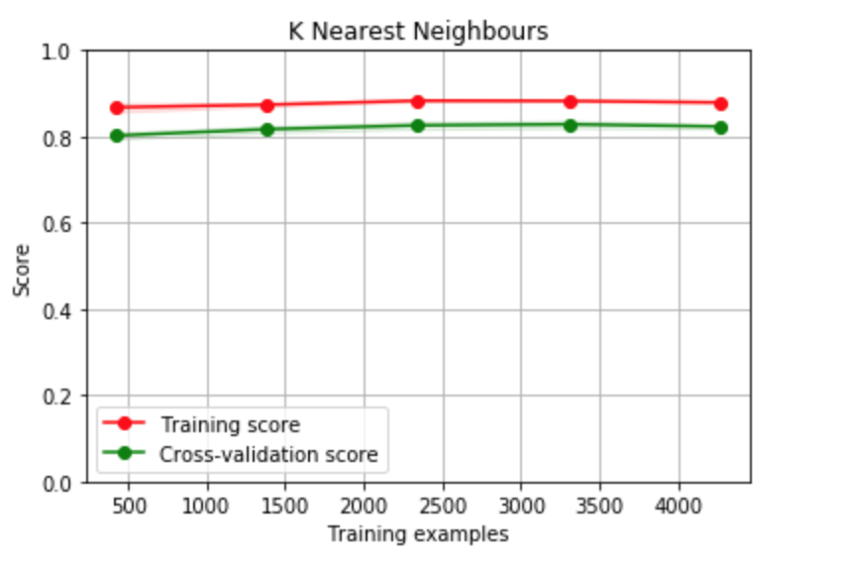
Text

Slide 40
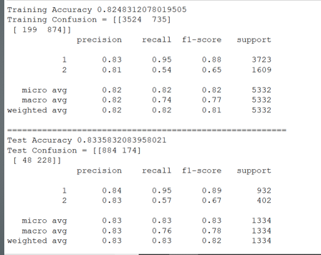
MODELING
NAIVE BAYES
Dependent : Gross revenue
Independent
Budget
Country
Genre
Rating
Run time
Score
Vote

Slide 41
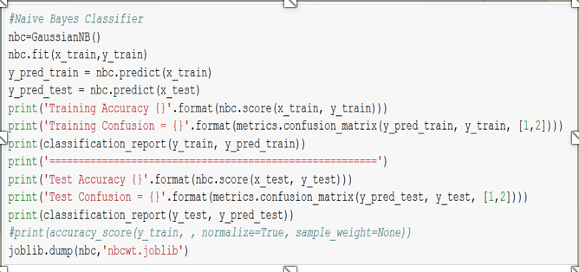
MODELing
NAIVE BAYES

Slide 42
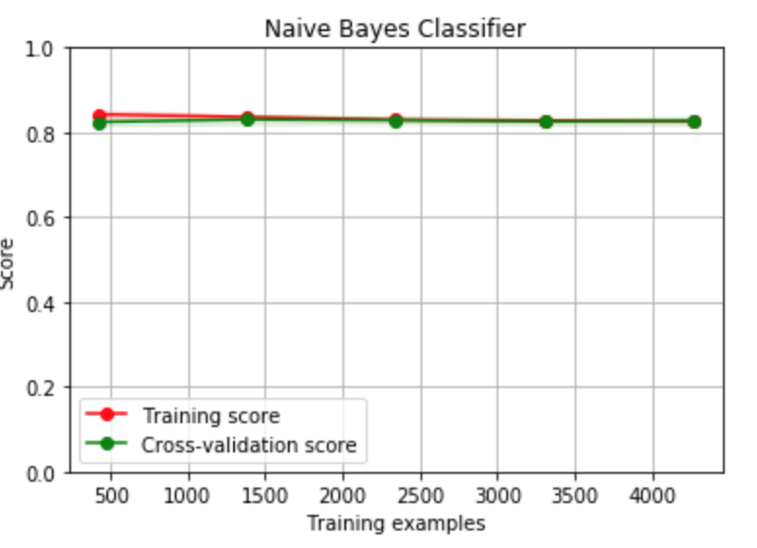
Text

Slide 43
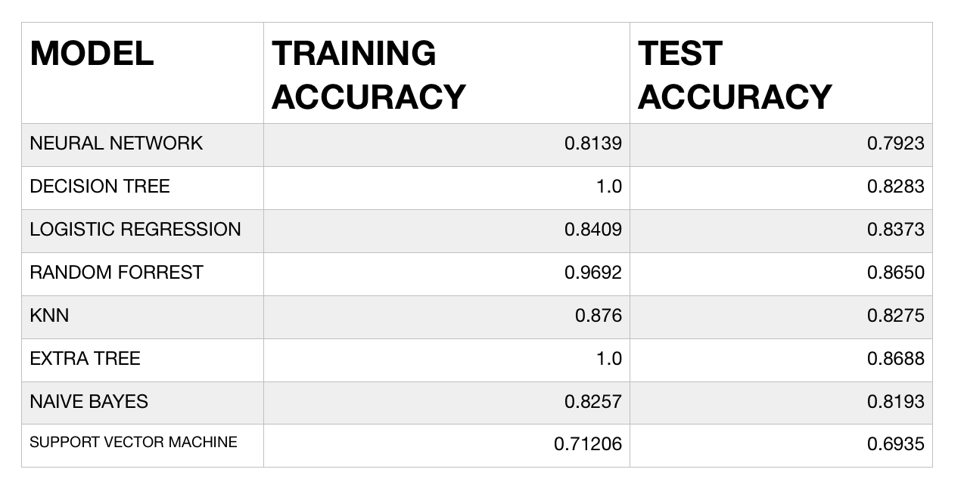
Modeling
MODEL SELECTION
The model selected is the one with the highest accuracy

Slide 44
EVALUATION
And
Deployment

Slide 45
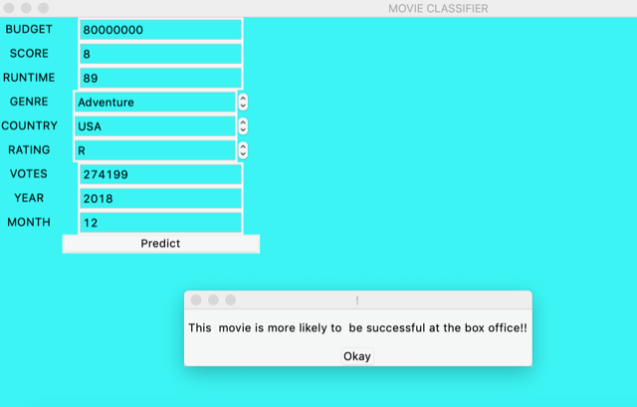
Evaluation And deployment
Application that we have created

Slide 46
Inference
On the more scientific side of our understanding , we inferred that the different machine learning models give predictions of different accuracies for the training and testing data set .
Through analysis of problem and the most important factors which affect success significantly , we have coded an applet usable by people without knowledge about computer codes to get instant simplified prediction about whether the movie will be a hit or a miss

Slide 47
Thank You

